Slide 1
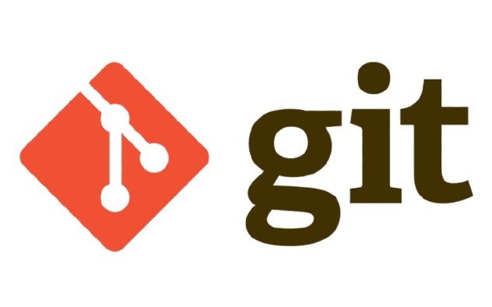

Git

Slide 2
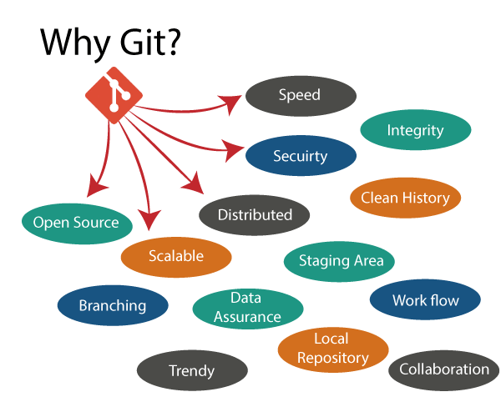
Version Control system:
A version control system is a tool that helps track, manage, and restore changes to files over time, especially in collaborative software development.
What is Git?
Git is a version control system that helps developers track changes in code and work together on projects.
Git was created by Linus Torvalds in 2005 to manage the development of the Linux kernel after issues with a previous tool called Bit Keeper.
Git is free, open-source, and widely used in both open-source and enterprise environments.

Slide 3
Why Git?
Traditional systems lack version tracking, making it difficult to manage changes, collaborate with others, and restore previous versions reliably.

Slide 4
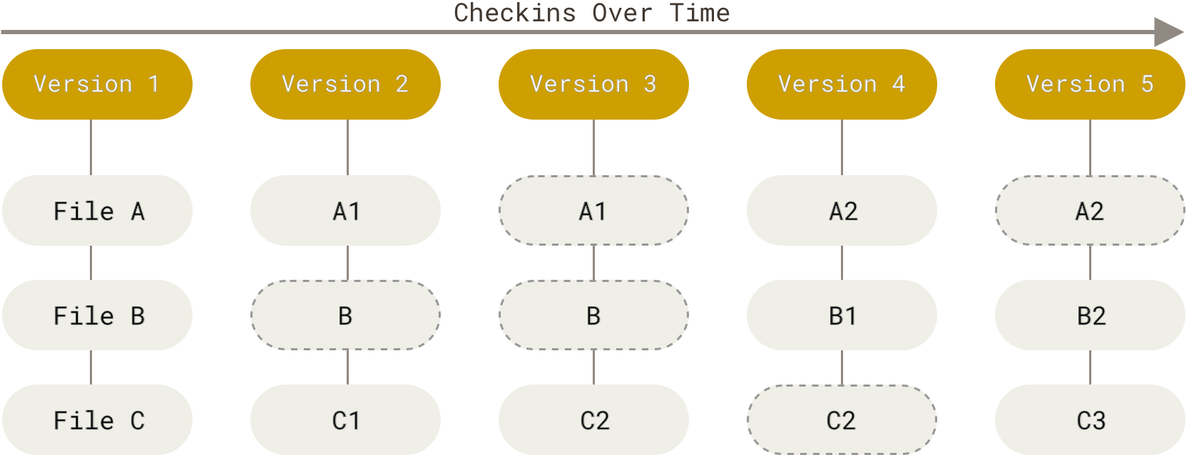
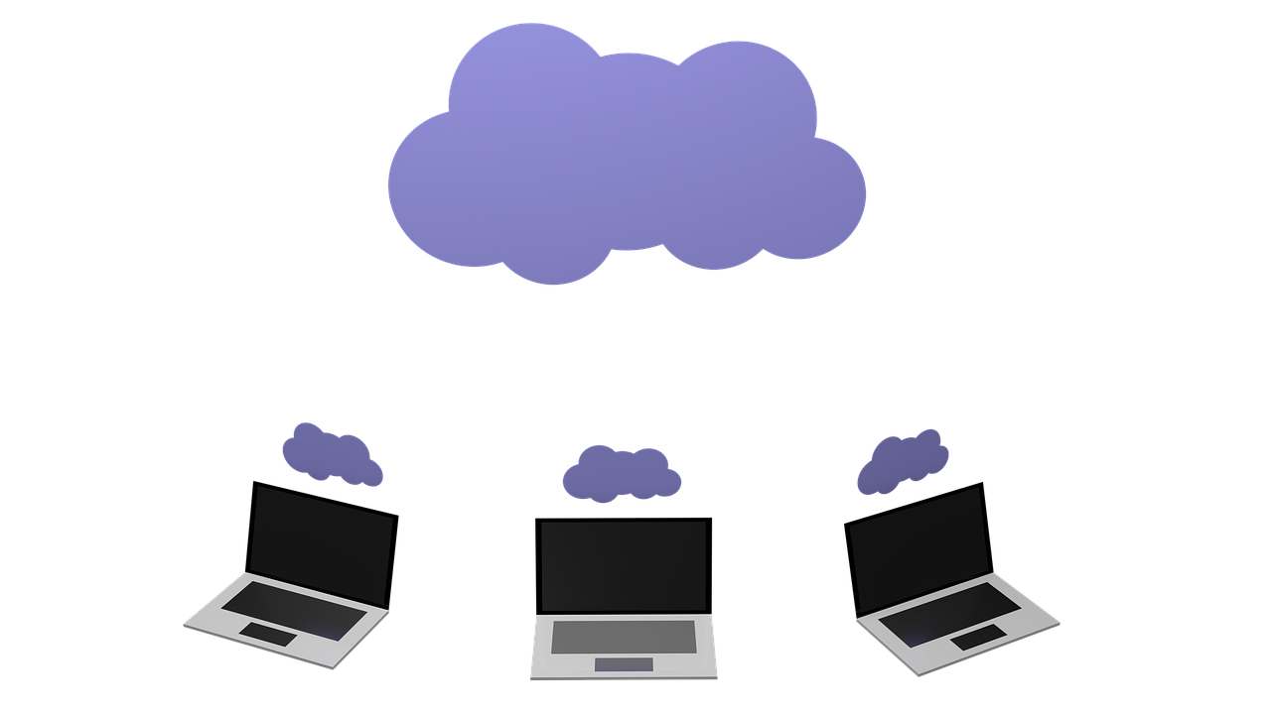
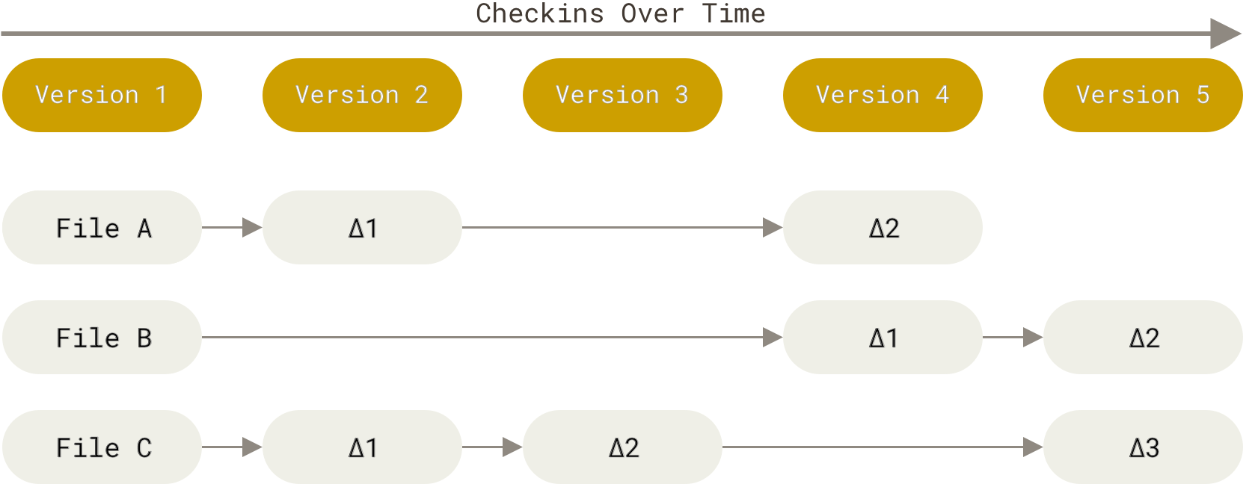
How Git Works?
Repository:
A repository (repo) is a folder that Git tracks, including your code and its entire change history.
It can be local (on our computer) or remote (like on GitHub or GitLab).

Slide 5
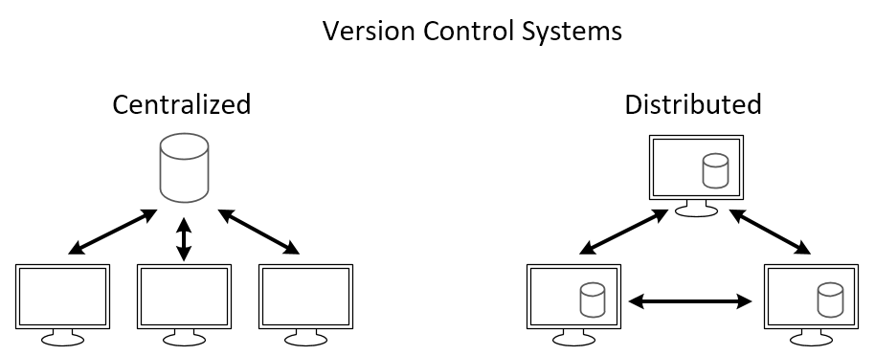
Snapshots vs differences:
In Git, every time you make a commit, it saves a full snapshot of your files — like taking a photo of your entire project at that moment.
Older version control systems (like SVN or CVS) saved only the differences (also called diffs) — meaning just the changes made to files since the last version.
Differences
Snapshots

Slide 6
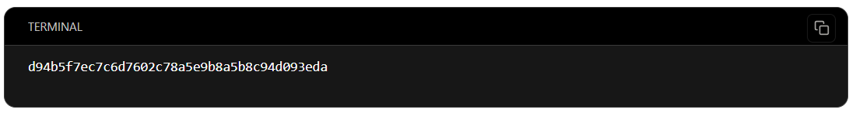
Distributed Version Control System:
A Distributed Version Control System is a system where every developer has a full copy of the entire project repository, including all files and the complete history.
Work offline, perform fast operations locally, and stay safe with a full backup on every developer's system.

Slide 7
SHA-1 hashing:
Git uses SHA-1 (Secure Hash Algorithm 1) to generate a unique 40-character hash for every commit, file, and object.
Even a tiny change in the file creates a completely new hash.
It helps Git track changes, verify data integrity, and prevent tampering.
git log – View full commit history with detailed info.
git log --oneline – View commits in a brief, one-line format.

Slide 8
Other Commonly Used Version Control Tools:
SVN, Mercurial, Perforce, Bazaar, CVS, Bit Keeper.
Benefits of Git over other systems:
Distributed system
Fast and efficient
Offline access
Better collaboration
Track history
Secure

Slide 9
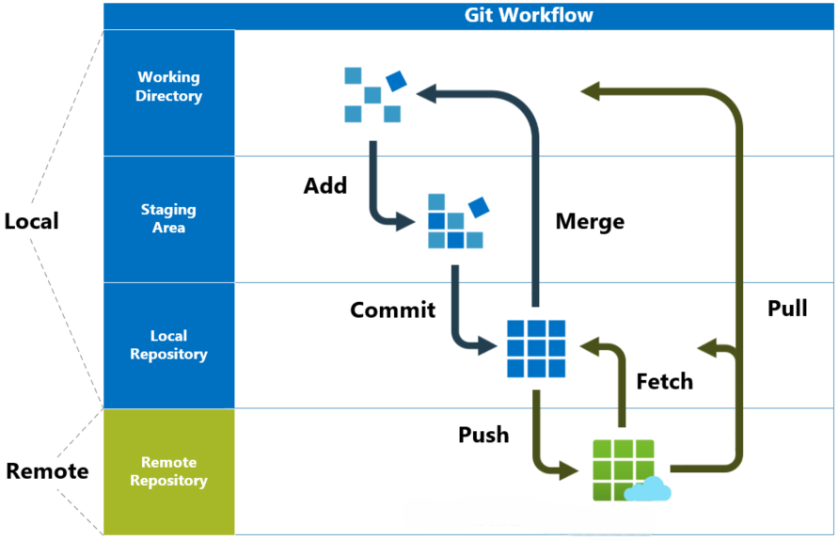
Git Work Flow:
Working Directory:
It is the local folder on your computer where you edit and create files.
Changes here are not yet tracked by Git until you stage them.
Staging Area:
Prepares selected changes to be committed.
Acts as a preview zone before saving to the local repository.
Local Repository:
Stores the full project history and committed changes on your system.
You can commit, view history, or revert without internet.
Remote Repository:
A shared Git repository (e.g., GitHub, GitLab) hosted online.
Allows collaboration by pushing and pulling changes across systems.

Slide 10
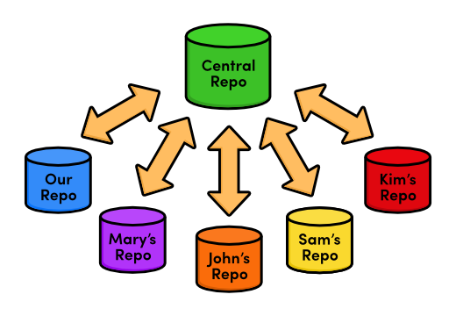
Git Work Flow:

Slide 11
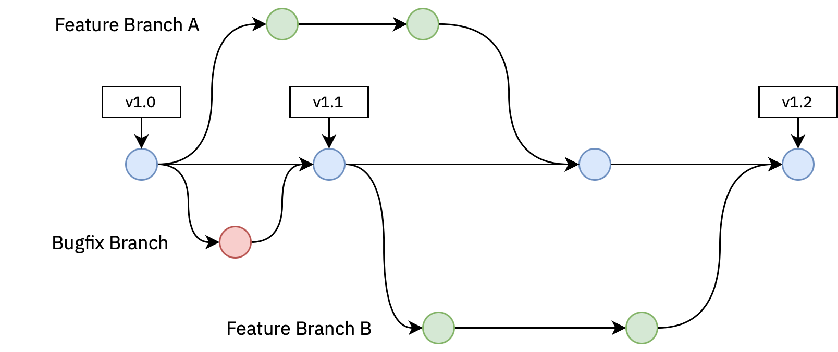
Common Git Workflows:
Centralized Workflow
Everyone commits to a single shared main branch.
Simple setup but not ideal for teams or parallel features.

Slide 12
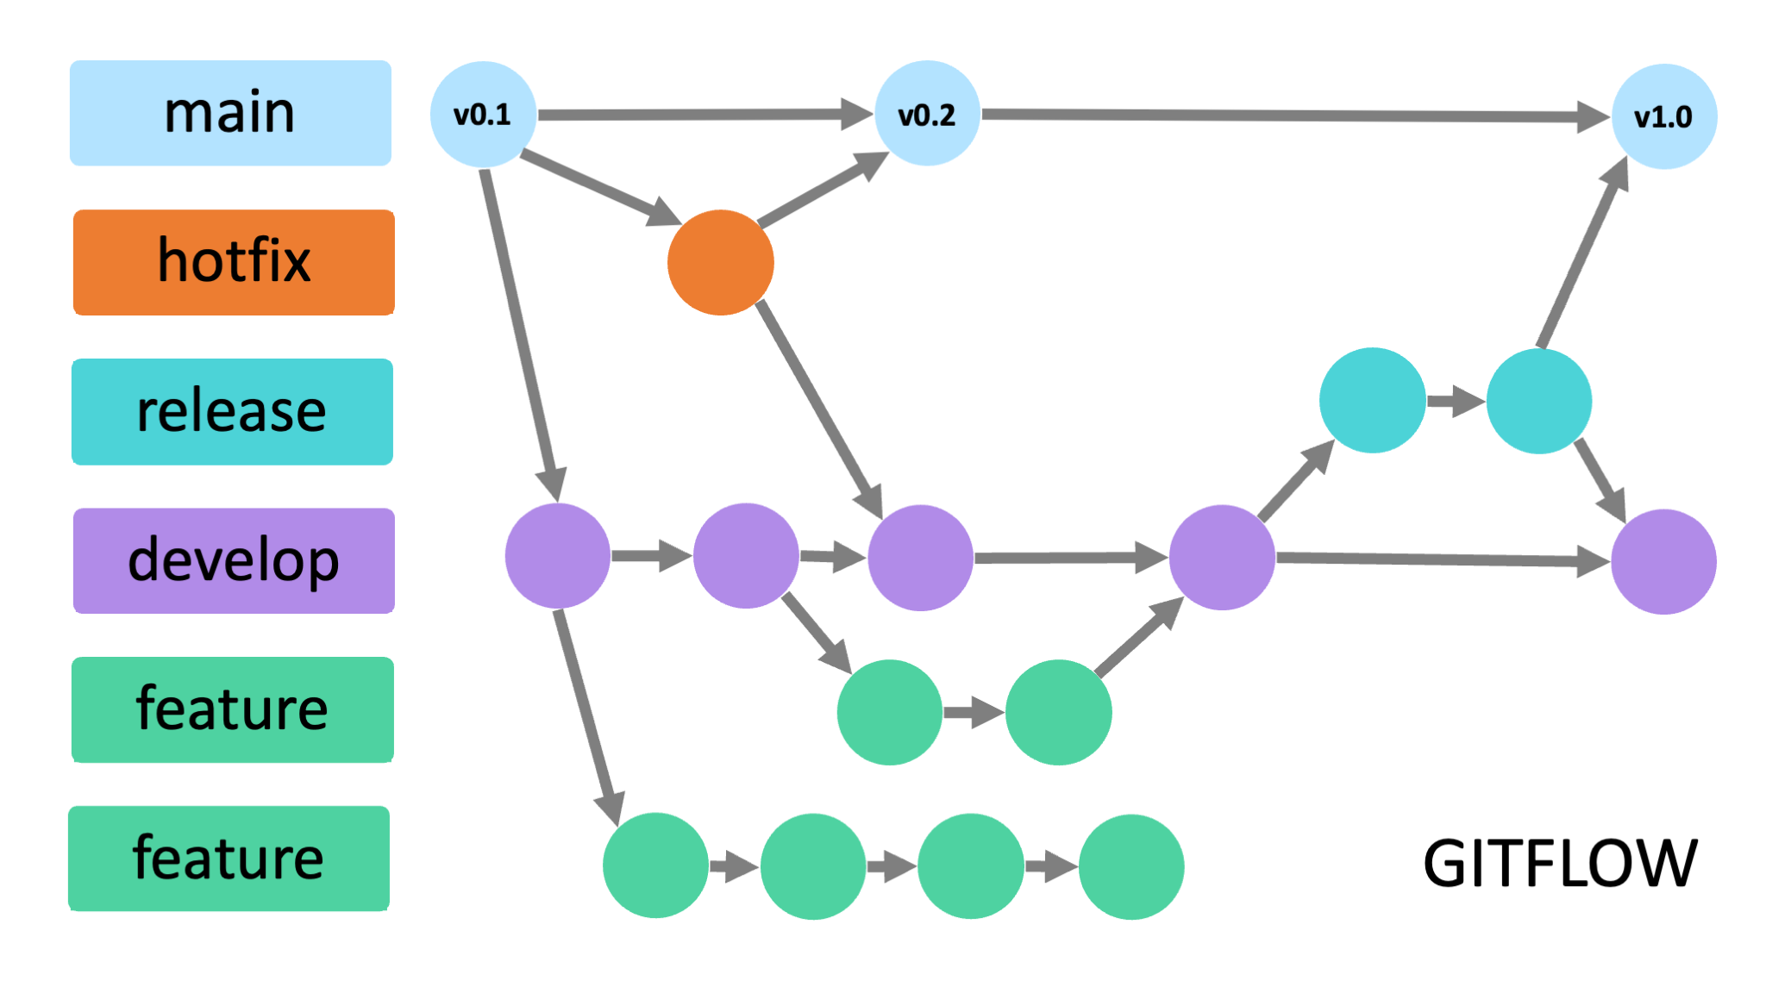
Feature Branch Workflow
Each task is done in a separate branch.
Main branch stays clean and stable.

Slide 13
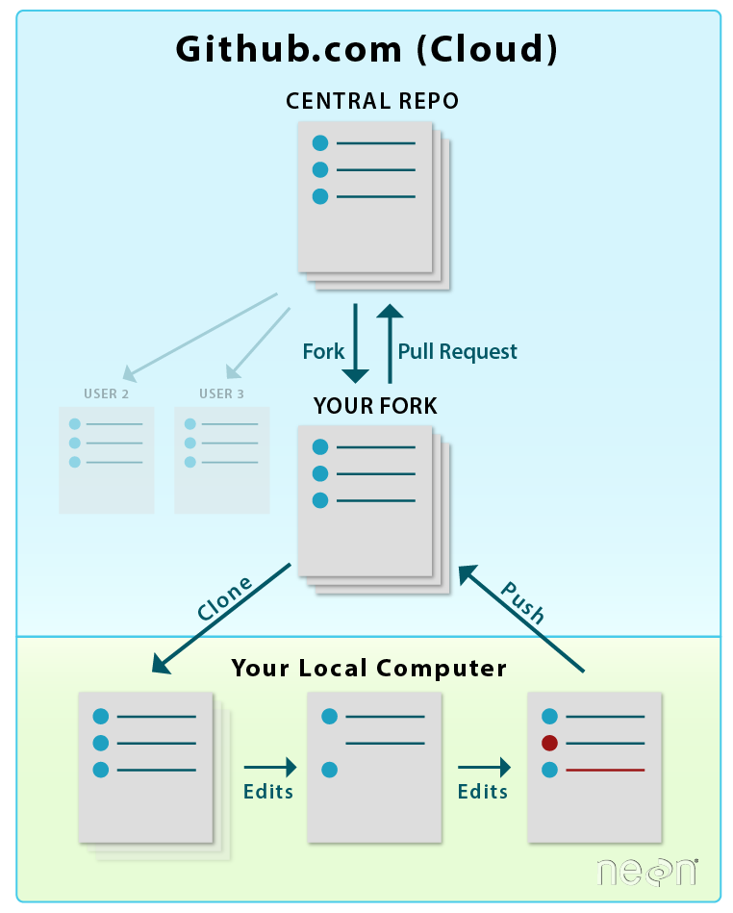
Git Flow work flow
Uses structured branches: main, develop, feature, release, hotfix.
Great for release management, but complex for beginners.

Slide 14
Forking Workflow
Developers fork the repo and work independently.
Contributions via pull requests to the original project.

Slide 15
Thank You

